Slide 1

STOCK MANAGEMENT SYSTEM
SOORYA SURESH K
MES21MCA-2052

Slide 2

CONTENTS
STOCK MANAGEMENT SYSTEM
INTRODUCTION
EXISTING SYSTEM
PROPOSED SYSTEM
MODULE DESCRIPTION
SYSTEM REQUIREMENTS
DATA FLOW DIAGRAM
USER STORIES
PRODUCT BACKLOG
PROJECT PLAN
SPRINT PLAN
Department of Computer Applications, MES College Of Engineering

Slide 3
INTRODUCTION
STOCK MANAGEMENT SYSTEM
In today's business environment, even many small businesses have come to rely on a computerized management system. The project entitled stock management system is a web application that facilitates the dealer and the owner to know about current stock availability in the shop. By using this application users can track stock in their shop and they will be notified to order new stock before a fixed period. Dealers can take orders online and deliver the products on time. Order is placed automatically whenever needed. Order is saved as a draft, which will generate a cart. The draft is created on behalf of the owner depending upon the price, quantity, and demand of the product, And also there will be a database that collects data on current stock including date of purchase, price, and quantity. This data generates a graphical representation of the products which have demand in the market, a minimum – maximum quantity list, and a sales report.
Department of Computer Applications, MES College Of Engineering

Slide 4
EXISTING SYSTEM
STOCK MANAGEMENT SYSTEM
There are several existing software, which provides a stock management system that functions for stock data collection and those applications allow only the owner to access it, And the order is taken manually. In existing system such as stock controller(2018),stock count (2018),smart inventory system etc. there is no tracking incoming stocks and these are less efficient and time consuming compared to the proposed system.
Department of Computer Applications, MES College Of Engineering

Slide 5
PROPOSED SYSTEM
STOCK MANAGEMENT SYSTEM
In this project, we assure both the dealer and the owner to use this application equally and the order was placed automatically. By using this application users can track stock in their shop and they will be notified to order new stock before a fixed period. Dealers can take orders online and deliver the products on time. Order is placed automatically whenever needed. Order is saved as a draft, which will generate a cart. The draft is created on behalf of the owner depending upon the price, quantity, and demand of the product, And also there will be a database that collects data on current stock including date of purchase, price, and quantity. This data generates a graphical representation of the products which have demand in the market, a minimum – maximum quantity list, and a sales report.
Department of Computer Applications, MES College Of Engineering

Slide 6
MODULES
STOCK MANAGEMENT SYSTEM
ADMIN
Login
Manage Distributors
Manage Shop Owners
View complaints and Send reply
View feedback
DISTRIBUTOR
Registration
Login
Product management
Take Order
View product demand
Department of Computer Applications, MES College Of Engineering

Slide 7
STOCK MANAGEMENT SYSTEM
SHOP OWNER
Registration
Login
Select Dealer
Sales bill generate
Purchase stockout Product
View Order Status
Monthly Sales report
Notification on Product re-order level
Department of Computer Applications, MES College Of Engineering

Slide 8
SYSTEM REQUIREMENTS
STOCK MANAGEMENT SYSTEM
HARDWARE REQUIREMENTS
• Processor : Intel core i3 and above
• RAM : 4GB or more
• Storage : 40 GB hard disk and above
Department of Computer Applications, MES College Of Engineering

Slide 9
STOCK MANAGEMENT SYSTEM
SOFTWARE REQUIREMENTS
• Operating System : Windows 8 or above
• Front End : HTML, CSS, JAVA SCRIPT, XML
• Back End : Python ,JAVA
• IDE : PyCharm community
• Web browser : Internet Explorer/Google Chrome/Firefox
Department of Computer Applications, MES College Of Engineering

Slide 10
STOCK MANAGEMENT SYSTEM
DATA FLOW DIAGRAM
Department of Computer Applications, MES College Of Engineering

Slide 11
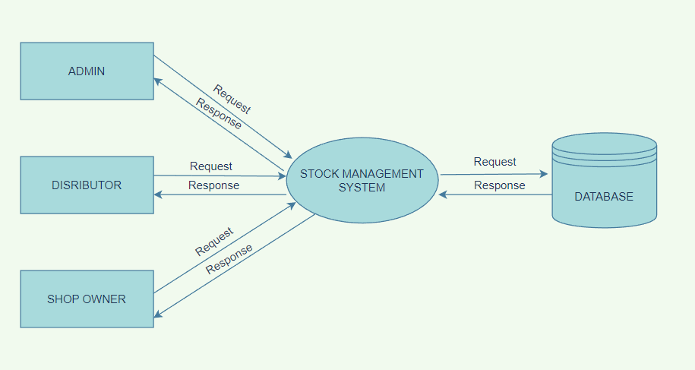

STOCK MANAGEMENT SYSTEM
LEVEL-0
Department of Computer Applications, MES College Of Engineering

Slide 12
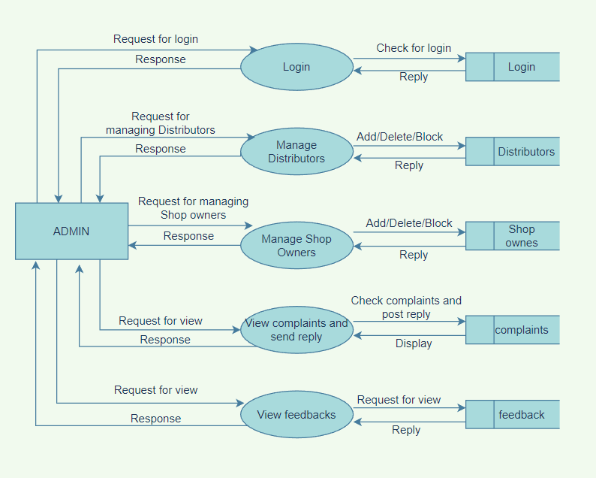
STOCK MANAGEMENT SYSTEM
Level-1 Admin
Department of Computer Applications, MES College Of Engineering

Slide 13
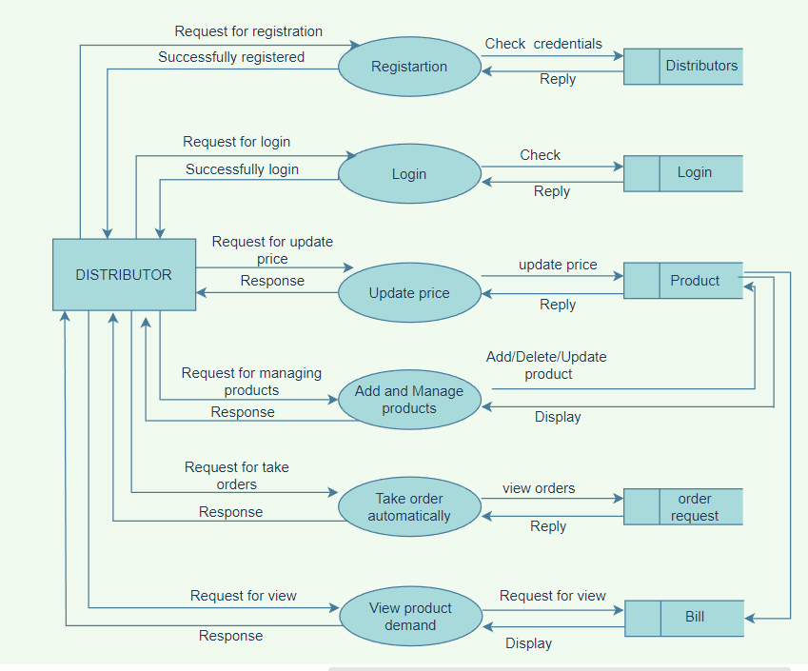
STOCK MANAGEMENT SYSTEM
Level 1 - Distributor
Department of Computer Applications, MES College Of Engineering

Slide 14
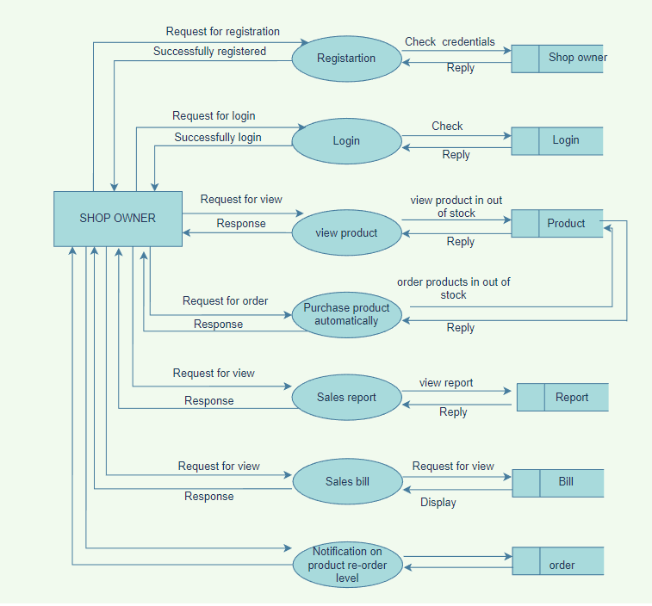
STOCK MANAGEMENT SYSTEM
Level - 1 Shop owner
Department of Computer Applications, MES College Of Engineering

Slide 15
USER STORIES
STOCK MANAGEMENT SYSTEM
UserStory_ID | As a <type of user> | I want to | So that I can
1 | Admin | Login | Login successful with correct username and password
2 | Admin | Manage Distributors | Manage Distributors by view/delete/block
3 | Admin | Manage Shop Owners | Manage Shop owners by view/delete/block
4 | Admin | View complaints and send reply | View complaints of users and post reply
5 | Admin | View feedbacks | View feedback given by the users
Department of Computer Applications, MES College Of Engineering

Slide 16
STOCK MANAGEMENT SYSTEM
UserStory_ID | As a <type of user> | I want to | So that I can
6 | Distributor | Registration | Create profile
7 | Distributor | Login | Login successful with correct username and password
8 | Distributor | Add and manage product details | Add/delete/edit product details
9 | Distributor | Take order | Accept orders
10 | Distributor | Update order status | Order status update
11 | Distributor | View product demand | Create sales report
Department of Computer Applications, MES College Of Engineering

Slide 17
STOCK MANAGEMENT SYSTEM
UserStory_ID | As a <type of user> | I want to | So that I can
12 | Shop Owner | Registration | Create a profile
13 | Shop Owner | Login | Login successful with correct username and password
14 | Shop Owner | Select dealer | Select Distributors
15 | Shop Owner | Sales bill | Sales bill generate
16 | Shop Owner | Update stock | Update product stock
Department of Computer Applications, MES College Of Engineering

Slide 18
STOCK MANAGEMENT SYSTEM
UserStory_ID | As a <type of user> | I want to | So that I can
17 | Shop Owner | Purchase stockout product | Less quantity items purchased
18 | Shop Owner | View order status | View status of orders
19 | Shop Owner | Sales report | View sales report by day/month/year wise
20 | Shop Owner | Notification on product re-order level | Product re-order notification
Department of Computer Applications, MES College Of Engineering

Slide 19
PRODUCT BACKLOG
STOCK MANAGEMENT SYSTEM
UserStory_ID | Name | Priority
1 | Login for admin | High
2 | View ,block/unblock distributors | Medium
3 | View ,block/unblock shop owners | Medium
4 | View complaints and send reply | High
5 | View feedbacks | Medium
6 | Registration for Distributors | High
7 | login | High
8 | Add and manage product details | Medium
9 | Take order | Medium
Department of Computer Applications, MES College Of Engineering

Slide 20
STOCK MANAGEMENT SYSTEM
10 | Update order status | High
11 | View product demand | High
12 | Registration for shop owners | High
13 | login | Medium
14 | Product view | Medium
15 | Purchase product | High
16 | View order status | High
17 | Update stock details | Medium
18 | Sales report | High
19 | Sales bill | Medium
20 | Notification on product re-order level | Medium
Department of Computer Applications, MES College Of Engineering

Slide 21
PROJECT PLAN
STOCK MANAGEMENT SYSTEM
UserStory_ID | Sprint | StartDate | EndDate | Day | Status
1 2 3 4 5 | SPRINT 1 | 07/02/2023 | 03/03/2023 | 25 | Completed
6 7 8 9 10 | SPRINT 2 | 04/03/2023 | 23/03/2023 | 19 | Completed
Department of Computer Applications, MES College Of Engineering

Slide 22
STOCK MANAGEMENT SYSTEM
UserStory_ID | Sprint | StartDate | EndDate | Day | Status
11 12 13 14 15 | SPRINT 3 | 23/03/2023 | 16/04/2023 | 27 | Planned
16 17 18 19 20 | SPRINT 4 | 17/04/2023 | 15/05/2023 | 29 | Planned
Department of Computer Applications, MES College Of Engineering

Slide 23
SPRINT PLAN :1
STOCK MANAGEMENT SYSTEM
Backlog item | Status and completion date | original Estimate (hours) | Day 1 07/02 | Day 2 08/02 | Day 3 09/02 | Day 4 10/02 | Day 5 13/02 | Day 6 14/02 | Day 7 15/02 | Day 8 16/02 | Day 9 17/02 | Day 10 20/02 | Day 11 21/02 | Day 12 22/02 | Day 13 23/02 | Day 14 24/02 | Day 15 27/02 | Day 16 28/02 | Day 17 01/03 | Day 18 02/03 | Day19 03/03
UI designing | 10/02/23 | 4 | 2 | 1 | 1 | 0 | 0 | 0 | 0 | 0 | 0 | 0 | 0 | 0 | 0 | 0 | 0 | 0 | 0 | 0 | 0
Coding | 21/02/23 | 8 | 0 | 0 | 0 | 0 | 1 | 2 | 0 | 2 | 0 | 2 | 1 | 0 | 0 | 0 | 0 | 0 | 0 | 0 | 0
Testing | 03/02/23 | 8 | 0 | 0 | 0 | 0 | 0 | 0 | 0 | 0 | 0 | 0 | 0 | 1 | 0 | 1 | 0 | 2 | 2 | 0 | 2
Total |  | 20 | 2 | 1 | 1 | 0 | 1 | 2 | 0 | 2 | 0 | 2 | 1 | 1 | 0 | 1 | 0 | 2 | 2 | 0 | 2
Department of Computer Applications, MES College Of Engineering

Slide 24
SPRINT PLAN :2
Backlog item | Status and completion date | original Estimate (hours) | Day 1 06/03 | Day 2 07/03 | Day 3 08/02 | Day 4 9/03 | Day 5 10/03 | Day 6 13/03 | Day 7 14/03 | Day 8 15/03 | Day 9 16/03 | Day 10 17/03 | Day 11 20/03 | Day 12 21/03 | Day 13 22/03 | Day 14 23/03
UI designing | 08/03/23 | 4 | 1 | 2 | 1 | 0 | 0 | 0 | 0 | 0 | 0 | 0 | 0 | 0 | 0 | 0
Coding | 17/03/23 | 12 | 0 | 0 | 0 | 3 | 1 | 2 | 0 | 3 | 1 | 2 | 0 | 0 | 0 | 0
Testing | 23/03/23 | 4 | 0 | 0 | 0 | 0 | 0 | 0 | 0 | 0 | 0 | 0 | 1 | 1 | 0 | 2
Total |  | 20 | 1 | 2 | 1 | 3 | 1 | 2 | 0 | 3 | 1 | 2 | 1 | 1 | 0 | 2

Slide 25

THANK YOU
THANK YOU

